Slide 1

Koryo Saram as part of
Global Korean Diaspora
by Victoria Kim

Slide 2
Global Korean Diaspora
80 million people:
90% or 70+ million people live on the Korean Peninsula,
10% or almost 8 million people are spread worldwide.

Slide 3
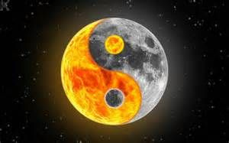
Overseas Koreans
1st place – China – over 2.5 million people
2nd place – USA – almost 2.5 million people
3rd place – Japan – over 800 thousand people
4th place – Canada – almost 250 thousand people
5th place – Uzbekistan – over 180 thousand people
Koryo Saram:
Uzbekistan + Russia + Kazakhstan = 180 + 170 + 110 = 460 thousand people
– 4th place globally

Slide 4
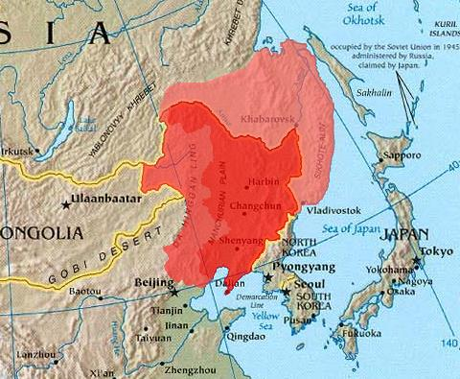
Koryo Saram and Chosŏnjok

Slide 5

Similarities:
Geopolitical proximity of Russian and Chinese borders to the Korean peninsula – outer and inner Manchuria (or Manchukuo),
Massive human outflow from Korea before and after the Japanese colonization and March 1st Movement in 1919:
by 1880s, 30 and 40 thousand Koreans lived across the Korean border in Russia and China,
by 1930s, their numbers augmented respectively to over 170 and 500 thousand people.

Slide 6
Similarities (continuation):
Introduction of rice as a new major agricultural crop in northern China and Russian (Soviet) Far East:
90% of rice in north-eastern China grown by 3.5% of the total population (Koreans), with the area increment of 48 to 125 thousand hectares by late 1930s,
90% of rice in Maritime Province grown by 20% of the total population (Koreans), with the area increment of 300 to 10 000 acres by 1937,
Common struggle against the Japanese invasion and colonization of Korea in 1905-1910 from across the Russian and Chinese borders.

Slide 7
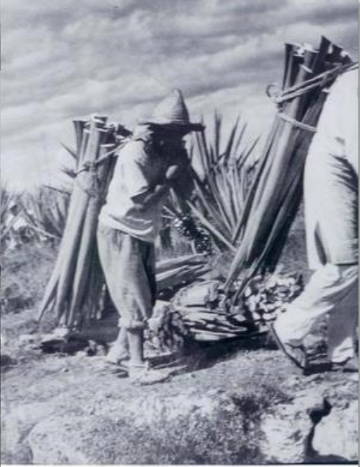
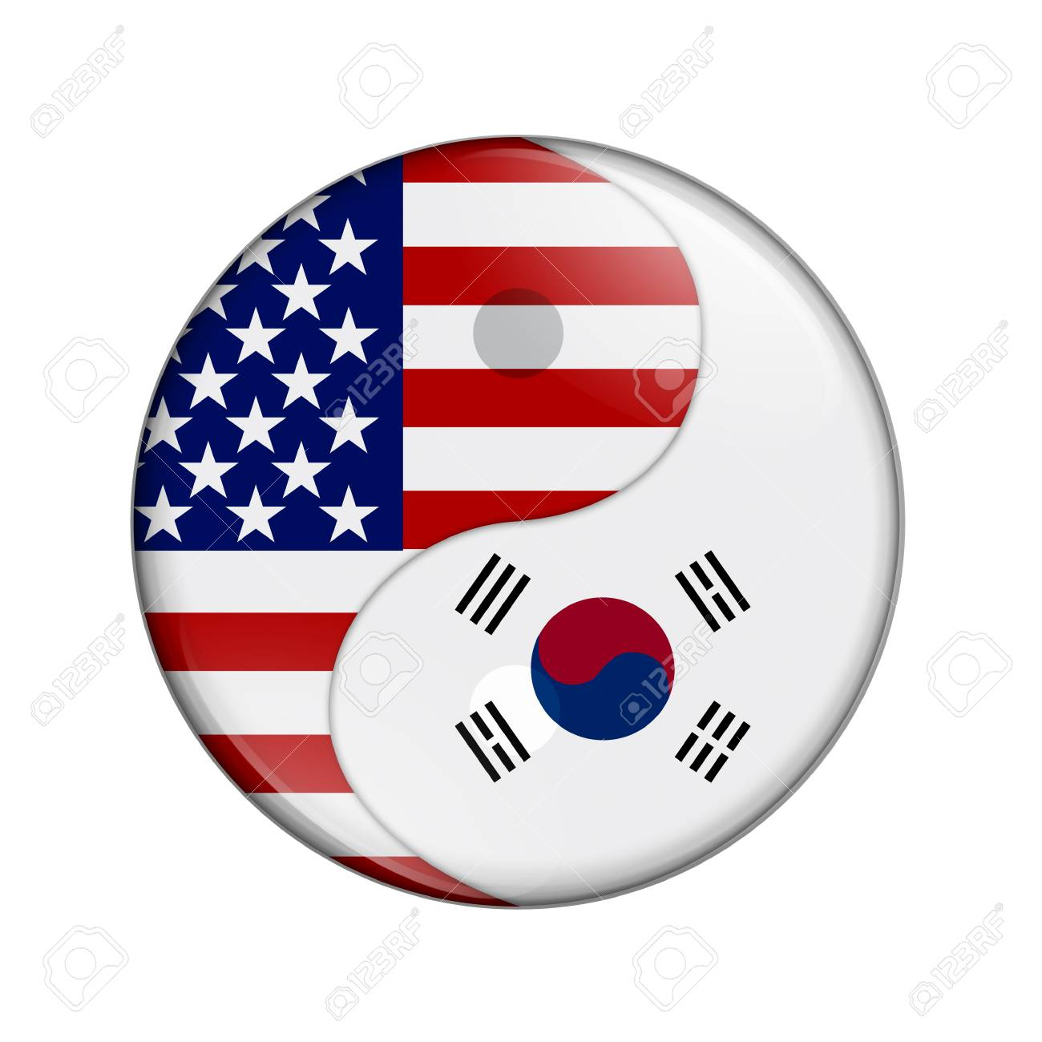
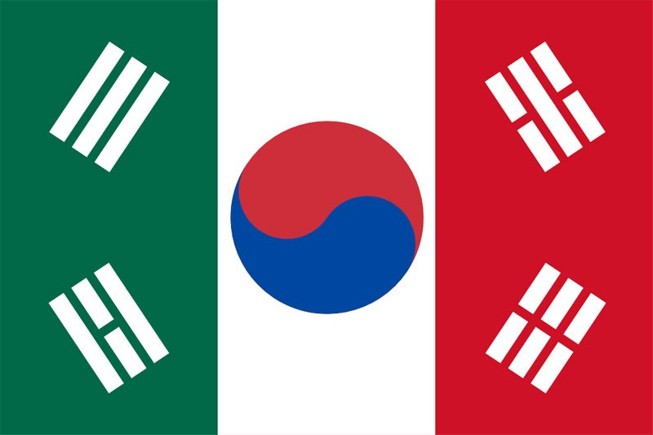
American and Mexican Koreans
Similarities:
Maritime migration,
Geopolitical isolation of the Korean diasporas in North America,
Sugar cane and henequén (cactus jute) grown as major crops,
Precarious initial working conditions with minimal pay (USA) or slavery (Mexico).

Slide 8
Cuban Koreans and Koryo Saram
Emigration (escape) from Mexico to Cuba in 1920s and deportation (forced resettlement) from Soviet Far East to Central Asia in 1937,
Agricultural strength of the diasporas (cane/henequén (jute) in Cuba vs. rice, grains, cotton and jute in Uzbekistan and Kazakhstan)
XX Communist Party Congress in USSR in 1956 and Fidel Castro’s communist revolution in 1959:
equal work opportunities and “friendship of nations” ideology,
growth to prominence of the Korean diasporas and their members as a result.

Slide 9
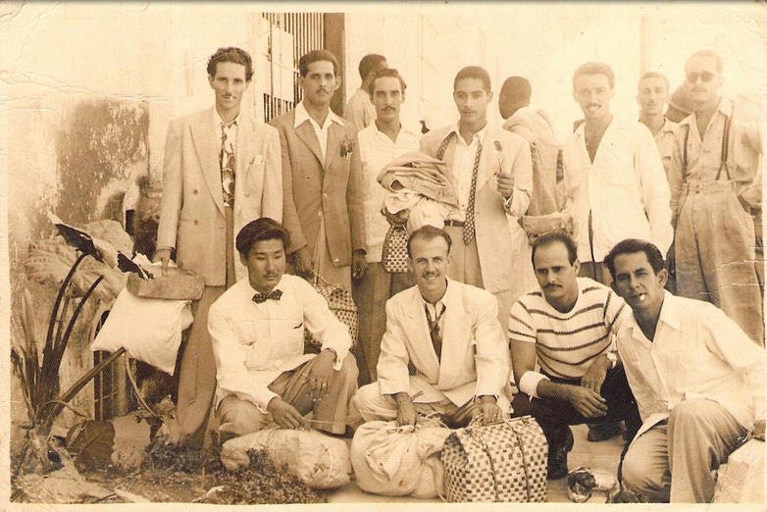
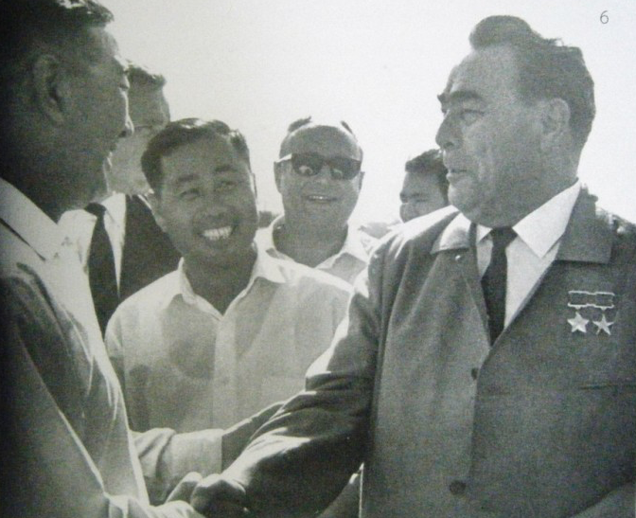
Cuban Koreans and
Koryo Saram (continuation)

Slide 10
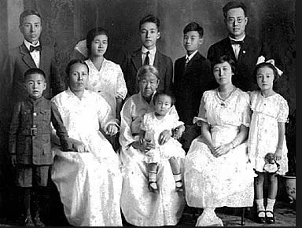
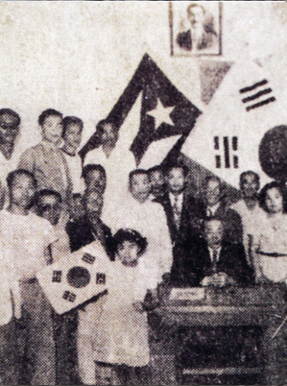
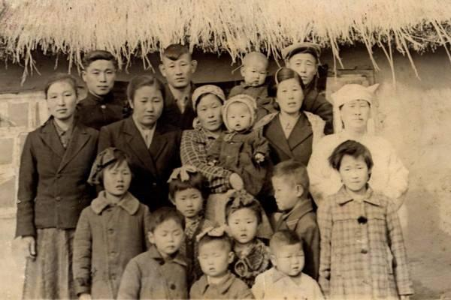
Global Korean Diaspora
United in Common Spirit and Roots,
and One Inseparable Soul

Slide 11
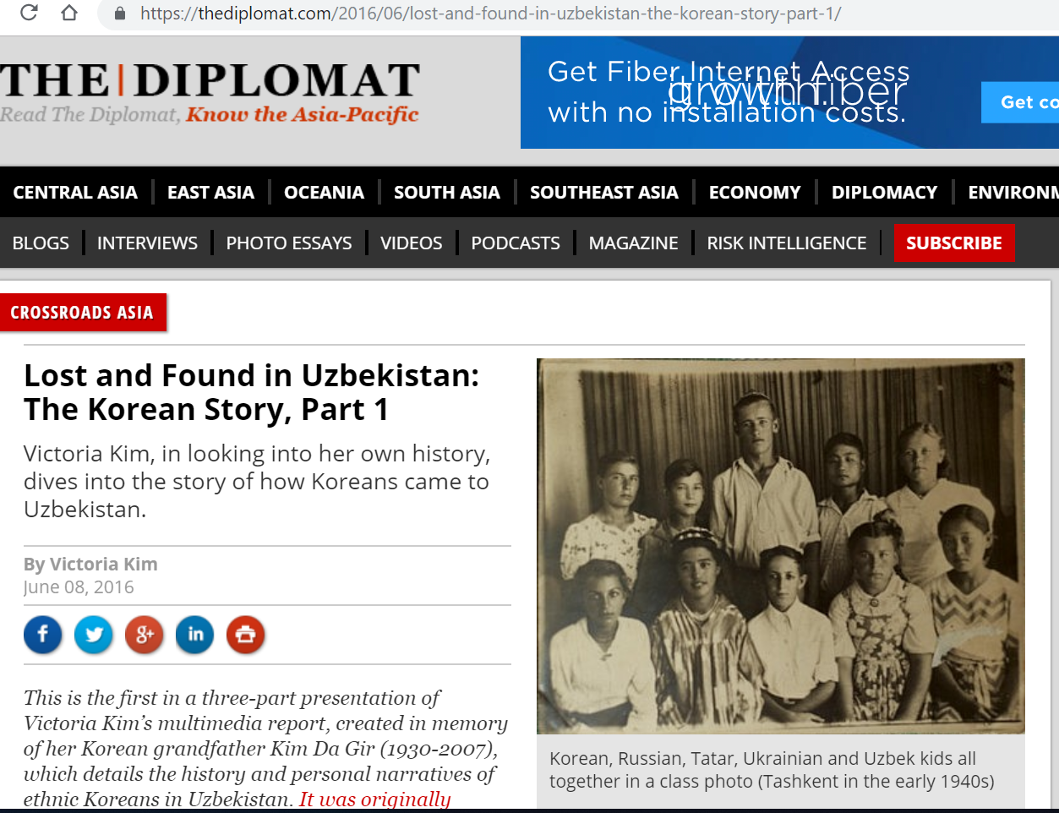

Slide 12
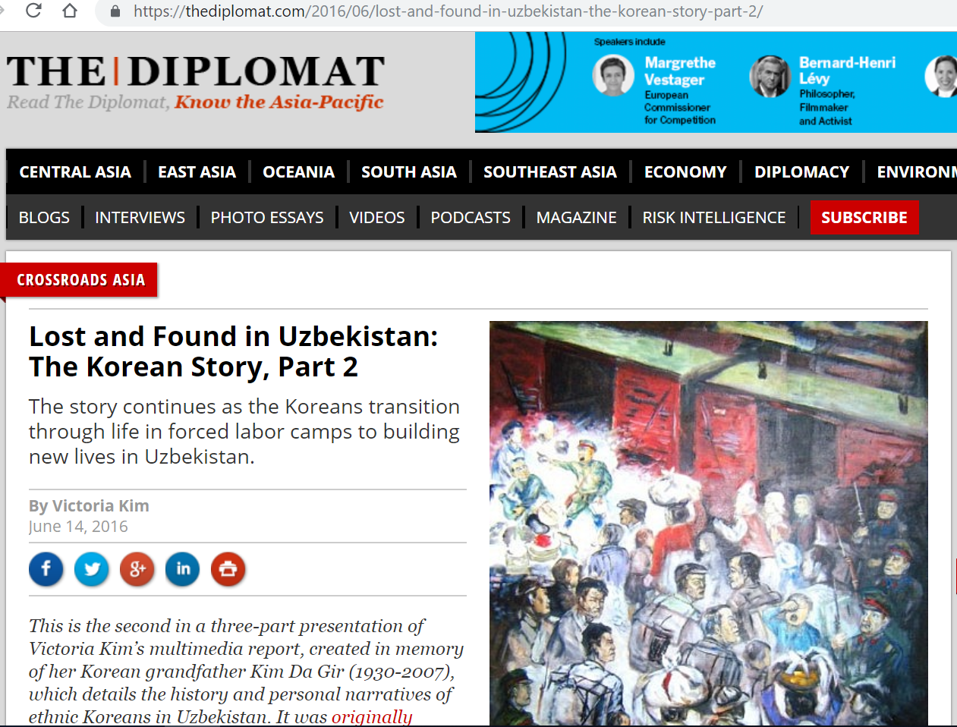

Slide 13
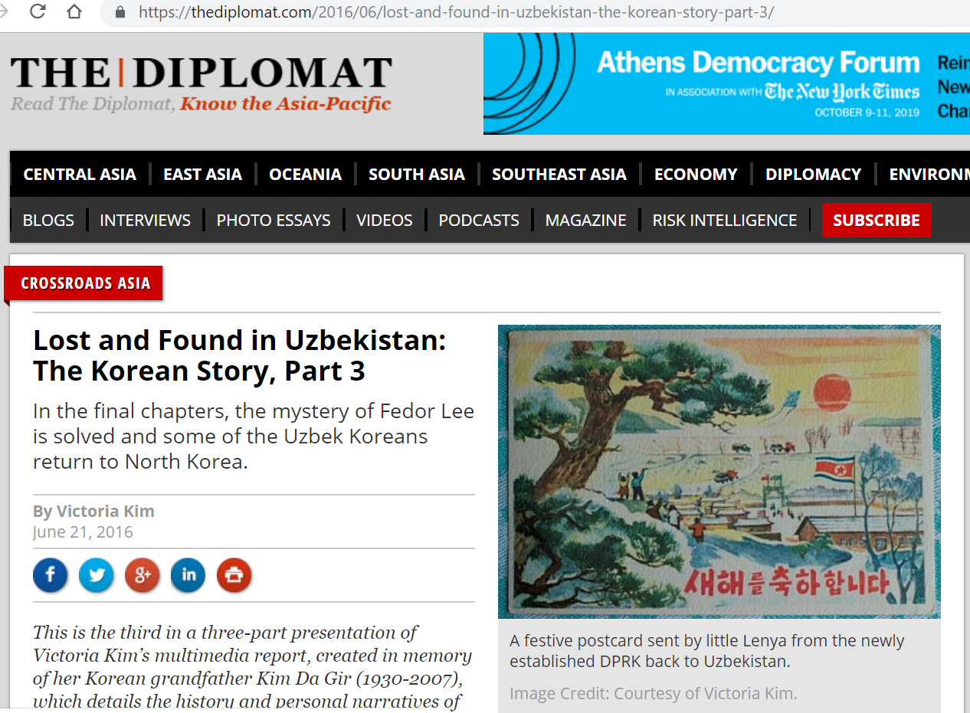

Slide 14
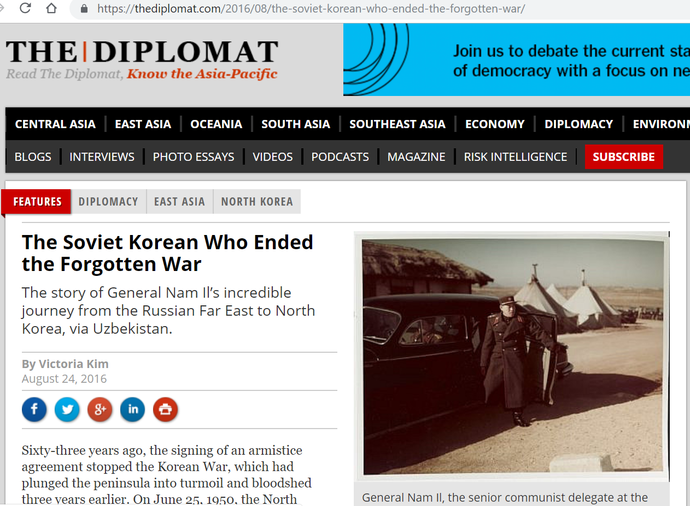

Slide 15
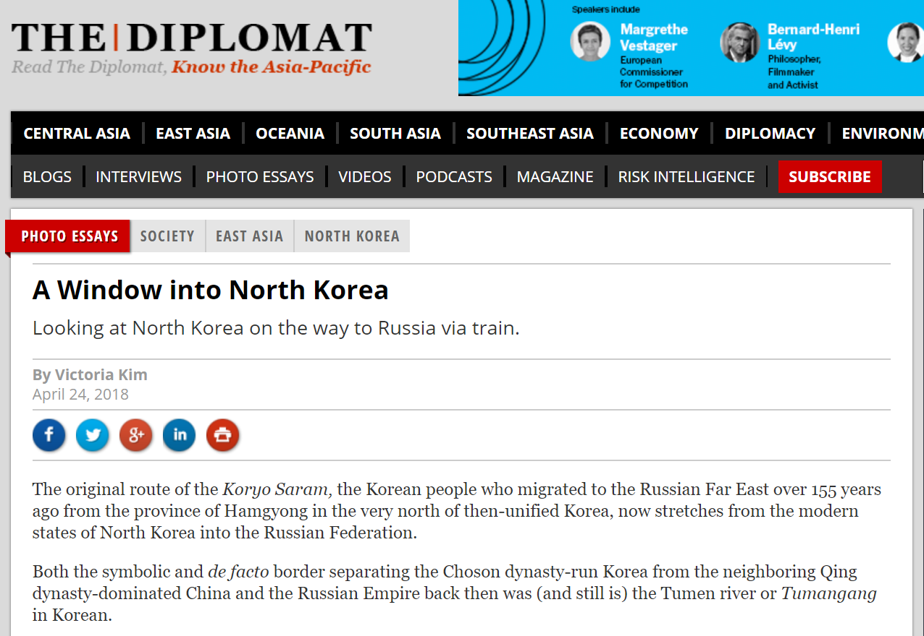

Slide 16
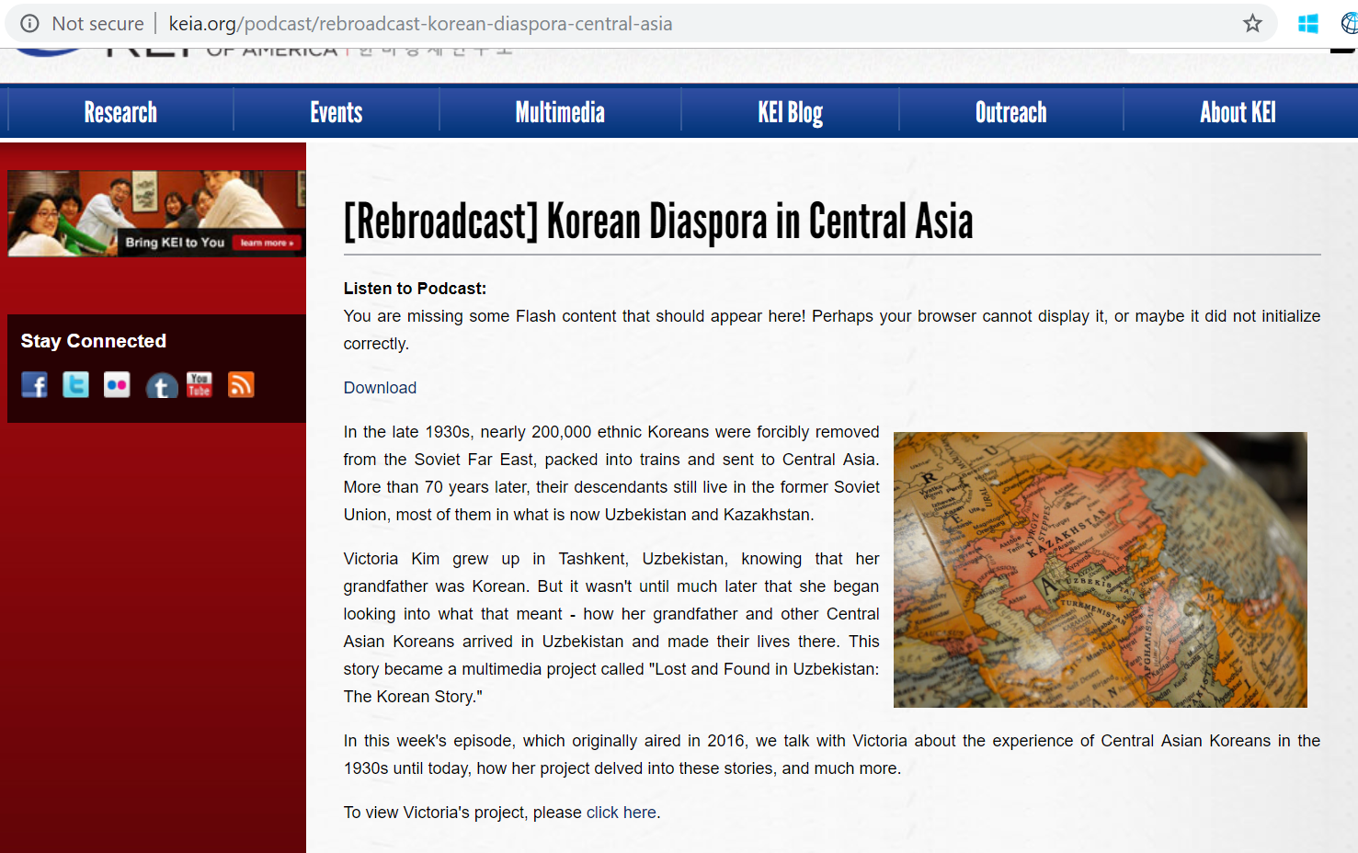

Slide 17
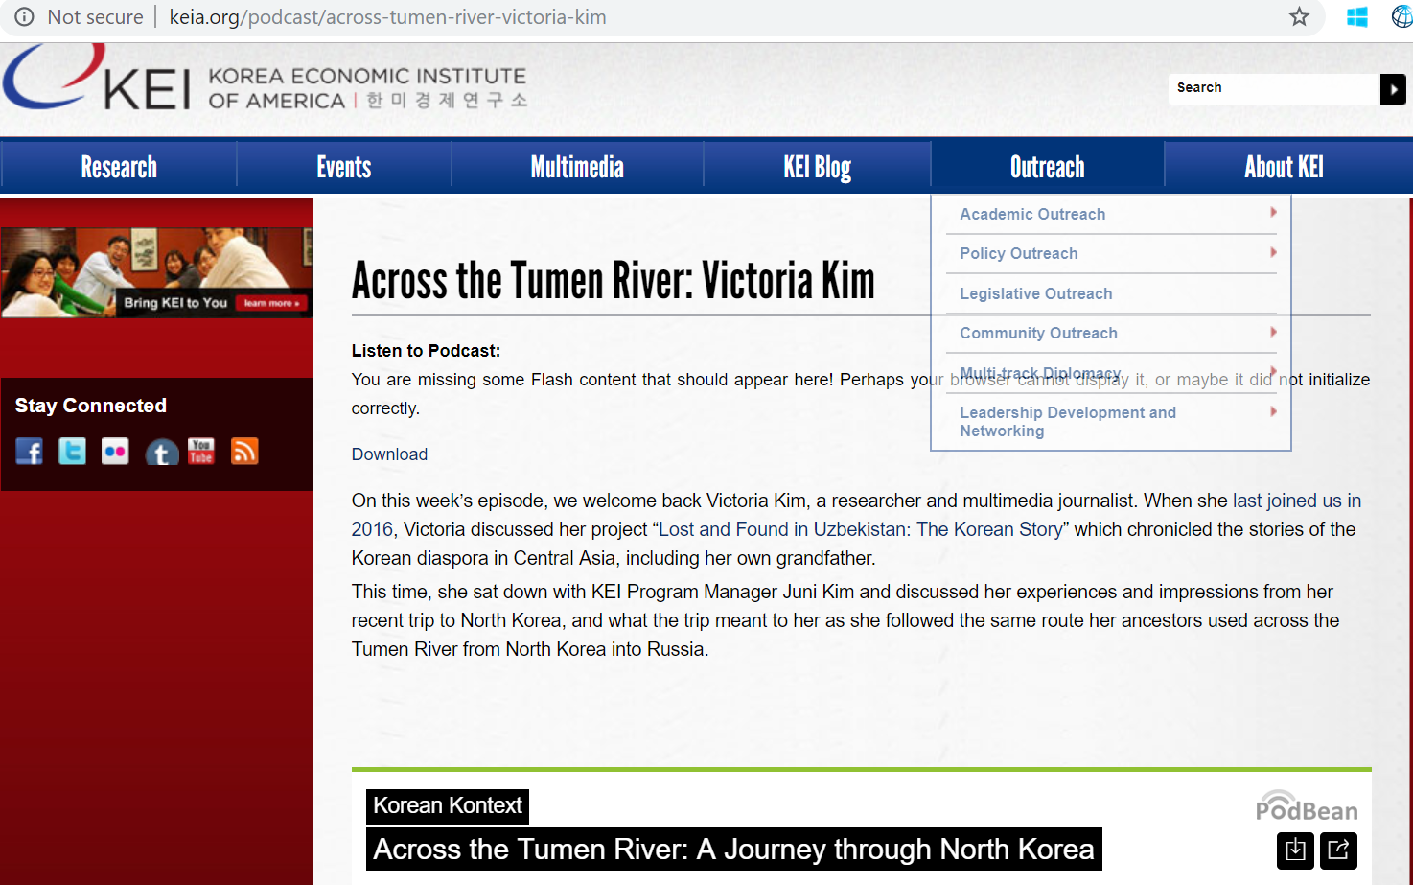

Slide 18
THANK YOU!
VKIMSKY@GMAIL.COM

